Slide 1
Stock value prediction using LTSM

Slide 2
Team Members
Niharika Bolledla – 700734351
Sowjanya Kondala – 700728487
Mounisha Kyatham – 700728716
Rajasekhar Reddy Chinnapureddy - 700734351

Slide 3
Roles and contributions
Team member 1 worked on collection of references.
Team member 2 worked on documentation like report, ppt.
Team member 3 made out conclusion and dataset collection to move on.
Team member 4 has done coding for the project.

Slide 4
Motivation
Financial gain is indeed the main driver behind attempts to forecast the value of stocks.
discovery of such a mathematical formula that could also accurately forecast that trend.
outperform its competitors, investors, analysts, including investing experts were constantly.

Slide 5
Objective
Market makers, researchers, politicians, and economists have all recently shown a renewed interest in method solves
The suggested work aims to investigate and enhance supervised learning systems for prediction of stock prices.
connectivity a enumerate of historical price levels.

Slide 6
Related work:
LSTM and stock exchange forecasting have a large body.
Fundamental analysis, technical analysis, and time series analysis are indeed the three basic types of financial sector forecasting and assessment.
Researchers then used LSTM, feeding it previous price information.

Slide 7
Problem statement
Time Series forecasting & modeling plays an important role in data analysis. Time series analysis is a specialized branch of statistics used extensively in fields such as Econometrics & Operation Research.
Time Series is being widely used in analytics & data science. Stock prices are volatile in nature and price depends on various factors. The main aim of this project is to predict stock prices using Long short-term memory (LSTM).

Slide 8

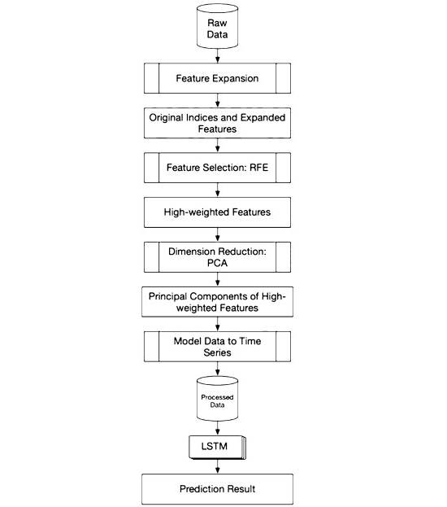
Proposed solution:
characteristic expansion. is the primary crucial technique.
classification expansion techniques are maximum-minimum scalability, polarization, and variation.
we split the commonly known of forecasting an actual figure into two consecutive challenges.
are transmitted to the PCA algorithm, which reduces the feature matrix scaling into j elements

Slide 9
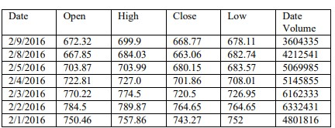
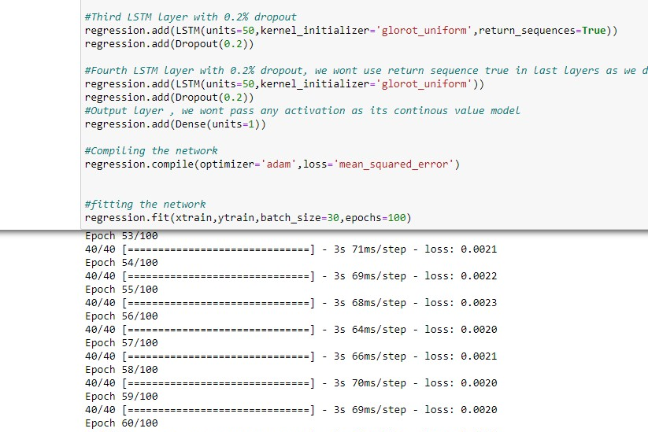
Preliminary Results:
Raw data for the project.
Fitting the model.

Slide 10
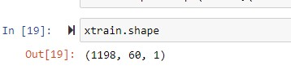
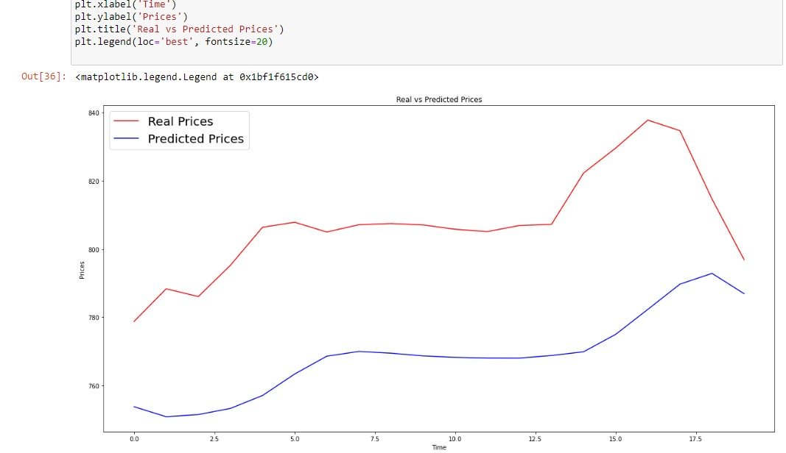
Graph real vs predicted values.
Trained data count.

Slide 11
References:
Eapen J, Bein D, Verma A. Novel deep learning model with CNN and bi-directional LSTM for improved stock market index prediction. In: 2019 IEEE 9th annual computing and communication workshop and conference (CCWC). 2019. pp. 264–70.
Brownlee J. Deep learning for time series forecasting: predict the future with MLPs, CNNs and LSTMs in Python. Machine Learning Mastery. 2018.
Idrees SM, Alam MA, Agarwal P. A prediction approach for stock market volatility based on time series data. IEEE Access. 2019;7:17287–98.
Jeon S, Hong B, Chang V. Pattern graph tracking-based stock price prediction using big data. Future Gener Comput Syst. 2018;80:171–87.
Liu G, Wang X. A new metric for individual stock trend prediction. Eng Appl Artif Intell. 2019;82(March):1–12.

